Slide 1
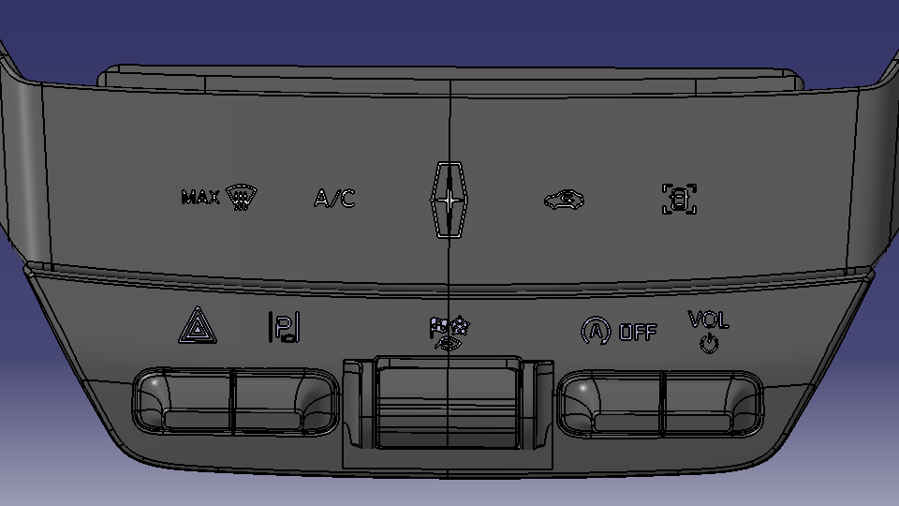
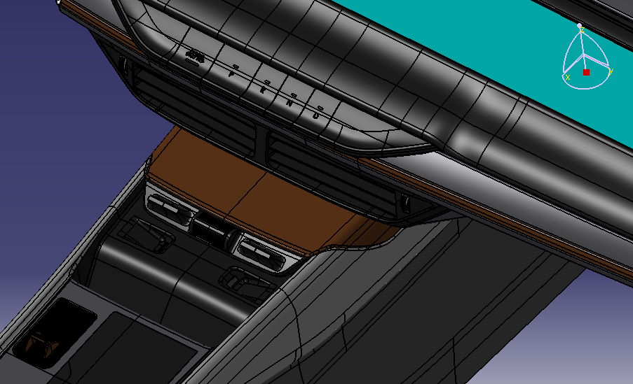



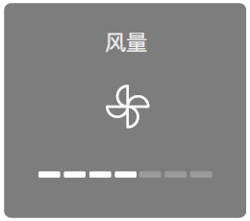
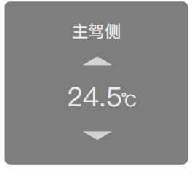
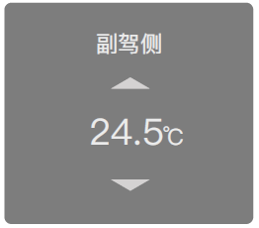
CD764 Mini ICP Design Requirement
CD764 Post AA Console Surface
Mini ICP
1
2
3
4
5
6
7
8
9
AUX
Temp Driver
Blower Speed
A/C
Temp Pass
If continuous pressed #6 toggle up/down, IVI sent several events to RCCM
HMI pop up blower speed +/- change rate as 5 steps per 1 second, Control mirror time pop out is 2S.
Example: If continuous pressed Temp + , HMI change from 1 bar to 6 bar in 1 second
1). Mini ICP Hardwire connected for below Buttons.
#1 Max Defrost, Touch button to RCCM and w/ indicator from RCCM feedback.
#3 Engine Start Stop, Touch button to RCCM and w/ indicator from RCCM feedback.
Blower Speed PoP out
2). Mini ICP LIN to AUX for below buttons signal Transmit & Receive.
#2 HVAC Power---Touch button for HVAC on/off, AUX transfer LIN to Private CAN signal to IVI, w/ indicator from IVI.
#4 DAT Hot key---Touch button Hot key for TCS & Auto Hold , AUX transfer LIN to Private CAN send to IVI , w/o indicator.
#5 Temp Driver--- Hard button for Driver side temp +/-, AUX transfer LIN to Private CAN send to IVI, w/o indicator.
#6 Blower Speed--- Hard button for blower speed +/-, AUX transfer LIN to Private CAN send to IVI, w/o indicator.
#7 SDM---Hard button for SDM +/-, LIN transfer to Publish CAN signal to ABS, w/o indicator from ABS.
#8 A/C---Hard button for Compressor on/off, AUX transfer LIN to Private CAN send to IVI , w/ indicator from IVI.
#9 Temp Passenger--- Hard button for Passenger temp +/-, AUX transfer LIN to Private CAN send to IVI ,w/o indicator.
SYNC+ Screen
If continuous pressed #5 or #9 toggle up/down, IVI sent several events to RCCM
HMI pop up Driver Temp +/- change rate as 10 steps per 1 second, Control mirror time pop out is 2S.
Example: If continuous pressed Temp + , HMI change from 23.5C to 28.5C in 1 second, 0.5C per step
Temp PoP out
SYNC+ Screen

Slide 2
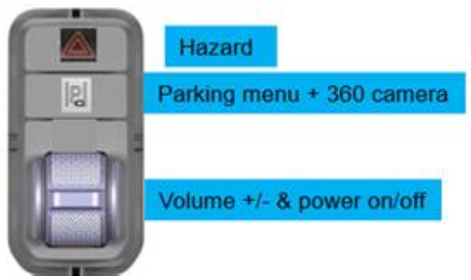
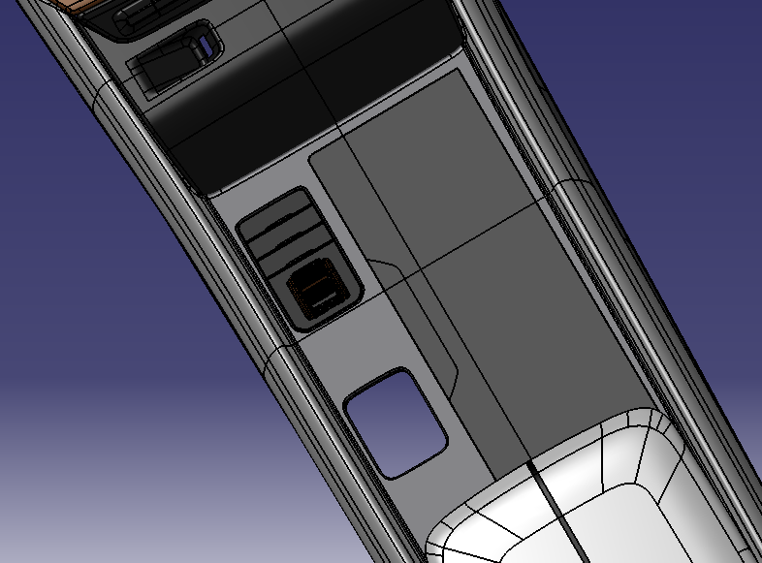
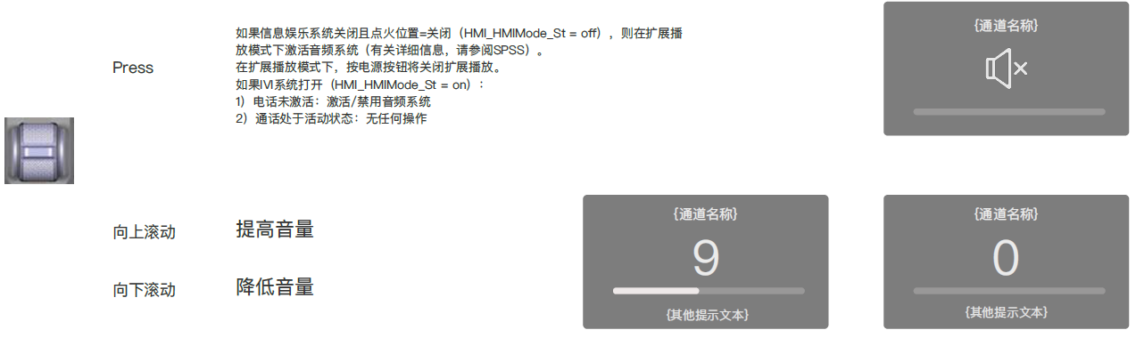
CD764 MFK Design Requirement
CD764 Post AA Console MFK Design Assumption
MFK
VOL
TEMP
AUX
1). MFK LIN to AUX , AUX transfer LIN to Private CAN.
Function:
Hazard --- Hard wire connect to BCM, and w/o indicator from BCM feedback ；
Parking Menu --- Hard wire connect to ADAS/PAAM and w/o indicator from ADAS/PAAM ;
Vol +/-, Audio Power on/off--- LIN to AUX, AUX transfer LIN to Private CAN send to IVI , be pressed for audio power on/off, w/o indicator.
Short Pressed --- Audio on/off; Long Pressed --- Audio Restart.

Slide 3
CX483C MCA Mini ICP Design Requirement
CX483C MCA Console Surface
Mini ICP
1
2
3
4
5
6
7
8
9
AUX
Temp Driver
Blower Speed
A/C
Temp Pass
If continuous pressed #6 toggle up/down, IVI sent several events to RCCM
HMI pop up blower speed +/- change rate as 5 steps per 1 second, Control mirror time pop out is 2S.
Example: If continuous pressed Temp + , HMI change from 1 bar to 6 bar in 1 second
1). Mini ICP Hardwire connected for below Buttons.
#1 Max Defrost, Touch button to RCCM and w/ indicator from RCCM feedback.
Blower Speed PoP out
2). Mini ICP LIN to AUX for below buttons signal Transmit & Receive.
#2 HVAC Power---Touch button for HVAC on/off, AUX transfer LIN to Private CAN signal to IVI, w/ indicator from IVI.
#3 Engine Start Stop, Touch button for ESS, AUX transfer LIN to Private CAN signal to IVI, w/ indicator from IVI .
#4 DAT Hot key---Touch button Hot key for TCS & Auto Hold , AUX transfer LIN to Private CAN send to IVI , w/o indicator.
#5 Temp Driver--- Hard button for Driver side temp +/-, AUX transfer LIN to Private CAN send to IVI, w/o indicator.
#6 Blower Speed--- Hard button for blower speed +/-, AUX transfer LIN to Private CAN send to IVI, w/o indicator.
#7 SDM---Hard button for SDM +/-, LIN transfer to Publish CAN signal to ABS, w/o indicator from ABS.
#8 A/C---Hard button for Compressor on/off, AUX transfer LIN to Private CAN send to IVI , w/ indicator from IVI.
#9 Temp Passenger--- Hard button for Passenger temp +/-, AUX transfer LIN to Private CAN send to IVI ,w/o indicator.
SYNC+ Screen
If continuous pressed #5 or #9 toggle up/down, IVI sent several events to RCCM
HMI pop up Driver Temp +/- change rate as 10 steps per 1 second, Control mirror time pop out is 2S.
Example: If continuous pressed Temp + , HMI change from 23.5C to 28.5C in 1 second, 0.5C per step
Temp PoP out
#3 Engine Start Stop on APIM Publish CAN:
Tx: APIM_Request_Signals (0x105) → StopStrtDrvMde_B_RqBtn3 Event
Rx: Stop_Start_HS3 (0X166) → StopStrtDrvMde_D_Indic fixed Period
SYNC+ Screen

Slide 4
CX483C MCA MFK Design Requirement
CX483C MCA Console MFK Design Assumption
MFK
VOL
TEMP
AUX
1). MFK LIN to AUX , AUX transfer LIN to Private CAN.
Function:
Hazard --- Hard wire connect to BCM, and w/o indicator from BCM feedback ；
Parking Menu --- Hard wire connect to ADAS/PAAM and w/o indicator from ADAS/PAAM ;
Vol +/-, Audio Power on/off--- LIN to AUX, AUX transfer LIN to Private CAN send to IVI , be pressed for audio power on/off, w/o indicator.
Short Pressed --- Audio on/off; Long Pressed --- Audio Restart.

Slide 5

CD764 ICA FHEV Mini ICP Design Requirement
CD764 ICA Console Surface
Mini ICP
1
2
3
4
5
6
7
8
9
AUX
Temp Driver
Blower Speed
A/C
Temp Pass
If continuous pressed #6 toggle up/down, IVI sent several events to RCCM
HMI pop up blower speed +/- change rate as 5 steps per 1 second, Control mirror time pop out is 2S.
Example: If continuous pressed Temp + , HMI change from 1 bar to 6 bar in 1 second
1). Mini ICP Hardwire connected for below Buttons.
#1 Max Defrost, Touch button to RCCM and w/ indicator from RCCM feedback.
Blower Speed PoP out
2). Mini ICP LIN to AUX for below buttons signal Transmit & Receive.
#2 HVAC Power---Touch button for HVAC on/off, AUX transfer LIN to Private CAN signal to IVI, w/ indicator from IVI.
#3 Recirc--- Touch button for HVAC Recirc, AUX transfer LIN to Private CAN signal to IVI, w/ indicator from IVI.
#4 DAT Hot key---Touch button Hot key for TCS & Auto Hold , AUX transfer LIN to Private CAN send to IVI , w/o indicator.
#5 Temp Driver--- Hard button for Driver side temp +/-, AUX transfer LIN to Private CAN send to IVI, w/o indicator.
#6 Blower Speed--- Hard button for blower speed +/-, AUX transfer LIN to Private CAN send to IVI, w/o indicator.
#7 SDM---Hard button for SDM +/-, LIN transfer to Publish CAN signal to ABS, w/o indicator from ABS.
#8 A/C---Hard button for Compressor on/off, AUX transfer LIN to Private CAN send to IVI , w/ indicator from IVI.
#9 Temp Passenger--- Hard button for Passenger temp +/-, AUX transfer LIN to Private CAN send to IVI ,w/o indicator.
SYNC+ Screen
If continuous pressed #5 or #9 toggle up/down, IVI sent several events to RCCM
HMI pop up Driver Temp +/- change rate as 10 steps per 1 second, Control mirror time pop out is 2S.
Example: If continuous pressed Temp + , HMI change from 23.5C to 28.5C in 1 second, 0.5C per step
Temp PoP out
#3 Recirc on APIM Publish CAN:
Tx: Clmt_Button_Stat4 (0x362) → Frt_Btn_Status_1st EP
Rx: Clmt_Button_Stat1_HS3 (0X360) → Recirc_Btn_Stt EP
SYNC+ Screen

Slide 6
CD764 ICA FHEV MFK Design Requirement
CD764 ICA Console MFK Design Assumption
MFK
VOL
TEMP
AUX
1). MFK LIN to AUX , AUX transfer LIN to Private CAN.
Function:
Hazard --- Hard wire connect to BCM, and w/o indicator from BCM feedback ；
Parking Menu --- Hard wire connect to ADAS/PAAM and w/o indicator from ADAS/PAAM ;
Vol +/-, Audio Power on/off--- LIN to AUX, AUX transfer LIN to Private CAN send to IVI , be pressed for audio power on/off, w/o indicator.
Short Pressed --- Audio on/off; Long Pressed --- Audio Restart.

